Slide 1
Azure Pipelines From New Project to Production in 60 Minutes
Kyle Noland Consultant - Microsoft 2:45 PM – Prosperity #devup2019

Slide 2


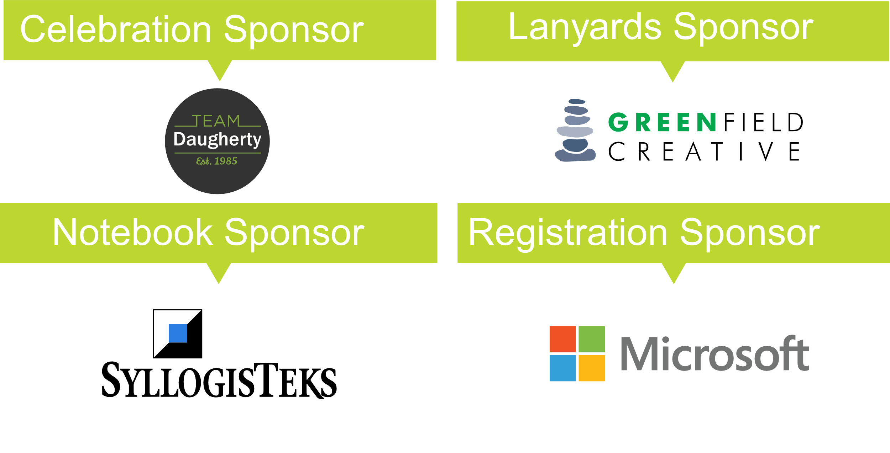


Slide 3




About Me
Lives near St. Louis, MO
Consultant – Apps Technical Delivery in Microsoft Services
B.S. & M.S. in Computer Science from University of Illinois Springfield
.NET Developer
Microsoft Certified Azure Developer Associate
@kylenoland

Slide 4
Problem Statement

Slide 5
Accelerating Delivery with DevOps
Develop
“
DevOps is the union of people, process, and products to enable continuous delivery of value to your end users.
”
DevOps
Operate
Deliver
Notes:
DevOps allows us to accelerate delivery, while still delivering reliable products and services
This is about bringing people together, through shared common goals, increased collaboration and a focus on improvement
Technology plays a key role in helping to execute a DevOps strategy by enabling teams to collaborate more, enhance productivity, facilitate experimentation and automate their processes from development, through to delivery and operations
It’s also about delivering value faster by increasing efficiency, eliminating waste and streamlining feedback back to developers to continuously improve the product
The result: better products, delivered faster, to happier customers
https://medium.com/@DonovanBrown_41367/dissecting-the-definition-69151da0435f

Slide 6
If It Hurts, Do It More Often
Develop
Find what hurts and keep doing it a bit better
Find the part of your process in getting value to customers that slows you down or hurts the most. Make it incrementally better each sprint. Re-evaluate and improve the next most painful.
“
Collaborate
”
Deliver
Operate
Notes:
DevOps is the union of people, process and products to enable the continuous delivery of value to your end customers

Slide 7
Our Goal
New Project using CI/CD….
….. Production?

Slide 8



➔
https://azure.com/devops
Build and Release to Any Cloud, Any Platform with Azure Pipelines

Slide 9
Technical Overview
.NET Core 2.2 Web App
Add Unit Tests
Add Docker Support
Build Testing Pipeline
Build Continuous Integration Pipeline
Build Continuous Delivery Pipeline

Slide 10
Technical Overview
Azure Repos – Git
Azure Pipelines
Azure DevOps Hosted Build Agents
Azure Container Registry
Azure App Service – Web App for Containers (Linux)

Slide 11
Demo

Slide 12
Kyle Noland
kyle.noland@microsoft.com
@kylenoland
http://aka.ms/devops
Thank you!

Slide 13
Appendix

Slide 14
References, Links, and Continued Learning
➔
https://azure.com/devops
https://aka.ms/yamlreference
https://learnxinyminutes.com/docs/yaml
https://github.com/features/actions
https://github.com/Microsoft/azure-pipelines-yaml
https://aka.ms/stateofdevops2019
https://aka.ms/multistagepipelines
https://azuredevopslabs.com
https://aka.ms/learn

Slide 15
Integrations
Teams & Slack Integration
Teams – https://aka.ms/teamsintegration
Slack – https://aka.ms/slackintegration

Slide 16









Home to the most important and popular open source projects on the planet

Slide 17
Heard of GitHub Actions?
Full CI/CD solution for GitHub
Supports a YAML syntax very similar to Azure Pipelines
Sign up at https://github.com/features/actions

